Slide 1
Charge Class Classification 14th Nov 2016

Slide 2
Solution Steps
Tighten Algorithm [11/23]
Syntactic * – Jaro and Levenshtein distance/ Damerau–Levenshtein distance
Semantic – Logistic and Deep Neural Network (boost confidence here)
*Note: This website provides comparison of syntactic algorithm (https://asecuritysite.com/forensics/simstring)
2. Batch Processing (bypass UI) [11/15]
Manipulating tables – Manually rectify the data and push it to relevant tables in bulk for learning to happen
Classification (by Claim ID) – club similar descriptions with minor difference under same claim id and pass it through application. Made the correction wherever applicable.
3. Performance improvements
Capture intermediate files
Indexing tables
Log performance metric
Reduce learning time – remove cross-correlation, window the system / incremental learning

Slide 3
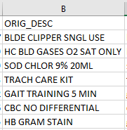
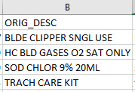
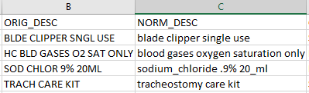
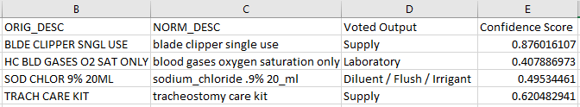
High Level Flow Diagram of Classification process
NORMALIZATION PROCESS
Abbreviation Check
Spelling Check
Spelling Suggestions
SYNTACTIC MATCH
Original Descriptions are filtered using syntactic match greater than 0.85
CLASSIFICATION ENGINE
Classify Descriptions using semantic & syntactic algorithms
Contd.

Slide 4
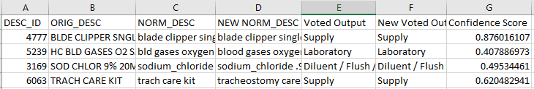
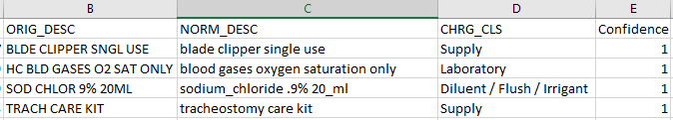
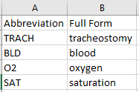
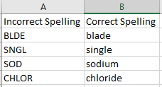
High Level Flow Diagram of Manual Review and Learning process
USER INTERFACE
Review Normalized Descriptions & Charge Class
LEARNING PIPELINE
Add Original, Normalized description & Charge Class having confidence < 1 to Training Data, Update Abbreviation & Spelling Corpora
Training Data
Abbreviation & Spelling Corpora
Central DB

Slide 5
Batch Processing (bypass UI)
Tables to be updated in order to reflect learning
ABBR_CORPUS
SPELL_CORR_CORPUS
TRNG_TABLE
In order to update table (a) and (b), we need to know
What is the incorrect form in description? i.e. words not present in dictionary
What is the correction required?
e.g.
Original description: LEVEL IV-SURG PATH GROSS/MICRO
Normalized description: level intravenous surgical path gross/microscopic
Things to be added in ABBR_CORPUS / SPELL_CORR_CORPUS (if not already present)
IV : intravenous
SURG : surgical
MICRO: microscopic
In order to update table (c), we need
Normalized description – To normalize the description table (a) and (b) will be used
Charge Class – We should be knowing this before hand.

Slide 6
Normalization Process
Original description
Abbreviation Check
Spelling check
Suggestion algorithm
Normalized description
Each word in description is matched with abbreviation present in abbreviation corpus table.
In case if multiple expansions are present for the same abbreviation then decision is taken based on bi-gram frequency*
Each word after abbreviation check is looked into dictionary to validate its correctness.
If word(s) in description is not present in dictionary then it will be checked in spell correction corpus to find the correct spelling
If not resolved in spell check step then algorithm will suggest 5 closest words
Word with highest unigram frequency* will be taken as suggestion
*Note: Bi-gram frequency, Unigram frequency: There are static flat files built upon 200K unique descriptions present in development environment.

Slide 7
Approach: Batch Processing (bypass UI) – Manipulating tables
Step 1: Club similar descriptions with minor differences under same claim id.
Step 2: Update abbreviation and spell correction corpus
In order to update these tables, run all descriptions through normalization process. Output of this process will give us
List of words that needs correction and their suggested correct format
Manual check needs to be made to validate this list
Validated list should be inserted back into abbreviation and spell correction corpus tables
Step 3: Obtain correct normalized description
Obtain correct normalized description after updating corpus tables
Step 4: Update charge class using a script
Assuming charge class will be known in advance.
Step 5: Insert Original description, normalized description and charge class into the TRNG_TABLE
Please note, Current normalization process needs to be tweaked to have an intermediate output. This output will give us
Incorrect word
Suggested word (if any)

Slide 8
Thank You

